Slide 1

AR2LT
GROUP 30:
MOHAMAD KARBEJHA - 20180301125
IMAD AL- KHAWAM -20190301539
MARWAN EL SABIE- 20180301093

Slide 2
Project Purpose And Targets
The purpose of this project is to build and create an program that converts images containing Arabic letters into it’s equivalent from Latin or English letters.
with the targets:
Faster And Alternative Way To OCR Arabic images
More Accurate experience For The User.

Slide 3
List of Functions
Upload image
Processing
Segmentation
Letter recognition
Final result

Slide 4
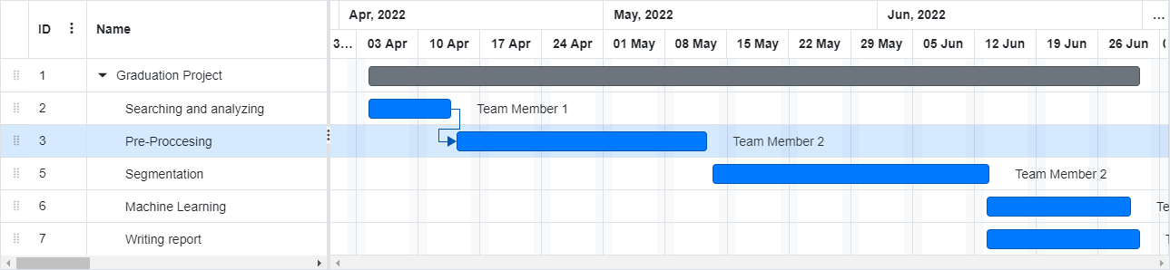
Gantt Chart:

Slide 5
ADVISOR MEETING TABLE
MEETING SUBJECT | ADVISOR NAME | DATE
Requirement Specification Meeting | Mustafa Zahid Gurbuz | 25/3/2022
Code Review Meeting | Dr. ARİF MURAT YAĞCI | 15/05/2022
Progress meeting | Dr. ARİF MURAT YAĞCI | 28/6/2022

Slide 6
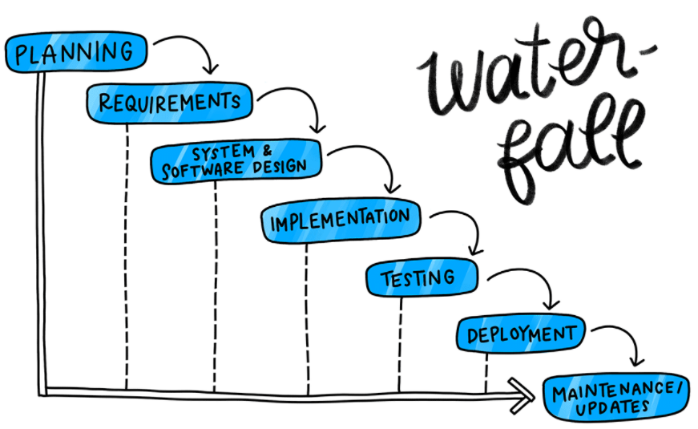
Its one of the oldest and most traditional models for building software's.
Waterfall development process
Working on tasks requires finishing each one sequentially before moving on. However, in most practical applications the phases overlap slightly, with feedback and information being passed between them

Slide 7
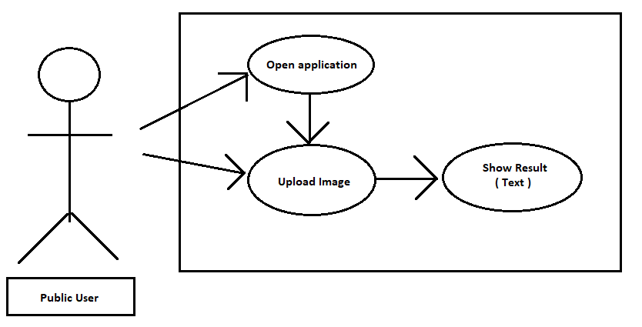
UML Use Case Diagram

Slide 8
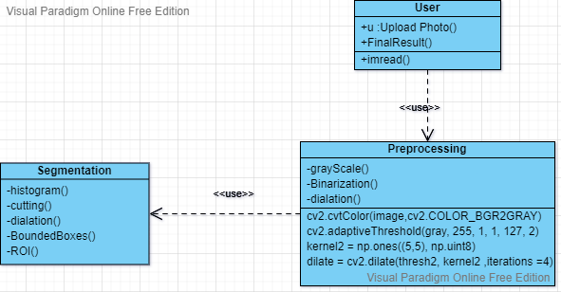
UML Use Class Diagram : Before Implementation

Slide 9
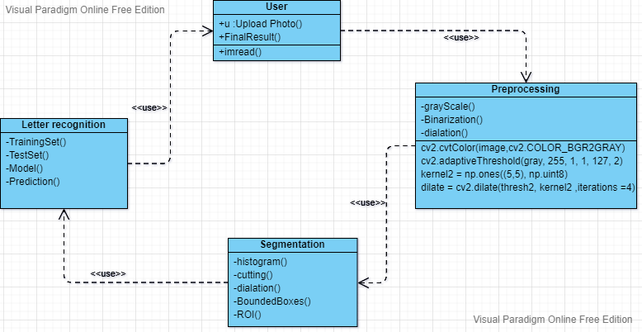
UML Use Class Diagram : After Implementation

Slide 10
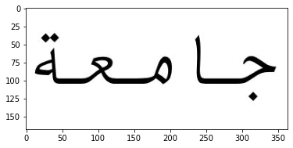
User interface mock-ups:
The user upload an image by putting its path on imread("path"):
First thing is the preprocessing part , which is all about filtering and adjusting the image.
1- Gray scaling the image:

Slide 11
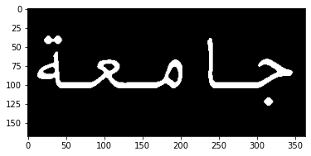
2-Binarization:

Slide 12
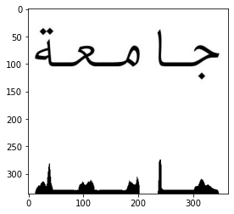
Segmentation part
1- Histogram profiling(Vertical):

Slide 13
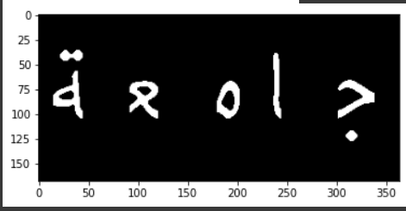




2-Cutting :

Slide 14
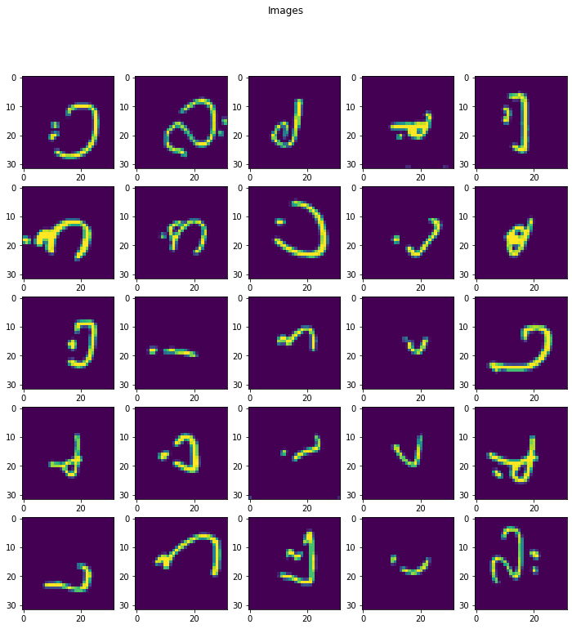
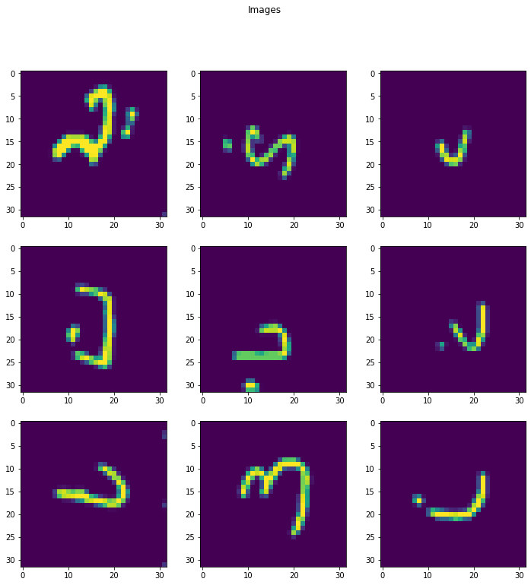
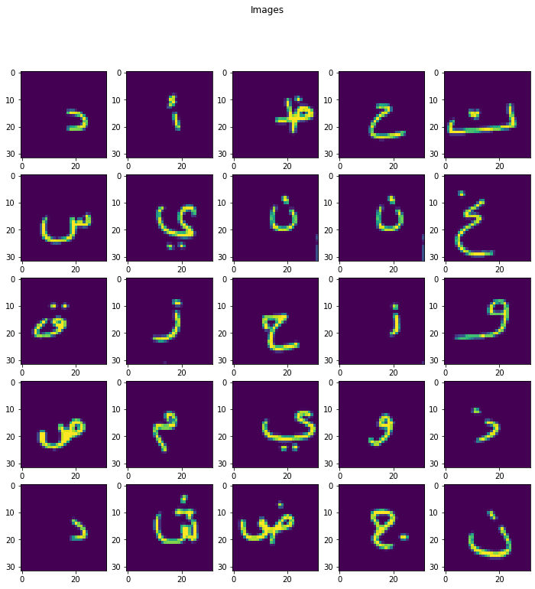
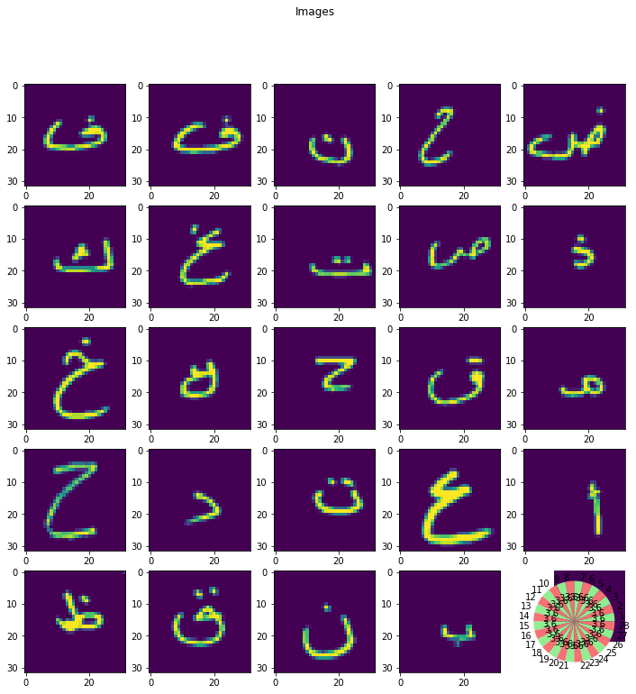
3-Machine Learning
*creating model ,train and test it:

Slide 15
*Finally, predicting our own image then display final result as Arabic text letter
And its equivalent to English or Latin letter.

Slide 16
Thank you for listening

